Slide 1

CEIR Visa Update Feature -Training Manual

Slide 2

Agenda
Feature
Stakeholder
State Diagram
UI Walk Thru
Update Visa for non-Registered User
Update Visa for Registered User
With Valid Visa
With No Visa Case

Slide 3

Feature Overview
Visa Update Feature allows end user to update their visa status in the CEIR Portal
This feature extend the device in the temporary whitelist as per the new visa dates
This feature is for foreigner user only
Typical flow is as follows:
End User
Visa Update Device
End user update visa details in the CEIR portal
CEIR Admin approve the request
CEIR System

Slide 4
Visa Upload (Only for Foreigner User – First time)

Slide 5
Visa Upload (Only for Foreigner User – Second Time)

Slide 6
Feature Impact / Use Cases
Importance of this feature for the CEIR System
Extension in temporary whitelist based on the visa update.
if the user does not update the visa and devices is used, it will be blocked in the network

Slide 7
Stakeholder Overview

Slide 8
Visa Update - Flow
Key Points
Foreigner End user should already registered on the system
The visa could be there or does not exist.
In case of “default” visa, visa date to be extended to 1 month (as per configurable period) from last date of visa expiry
Update Visa
Check User Information Exist
No
Return Error
No
Update Visa Details
Do Visa exists
Yes
Update as per visa details
No
Update as per default period configuration
Send for CEIR Approval

Slide 9
State Transition – Overview – Visa Update
End User
System
CEIR Admin
Approved
Visa Update Request State under various Stakeholder
NEW
PROCESSING
Pending for CEIR Approval
Update Visa
System
Procesing
System
Process
Approve
System
Process
Edit
Reject
Rejected by System
Rejected by
CEIR Admin

Slide 10
State Transition - Overview

Slide 11
UI – Overview - Feature

Slide 12
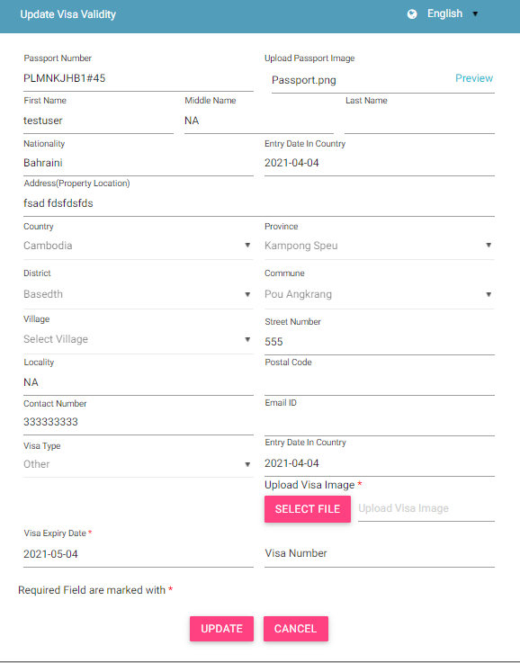
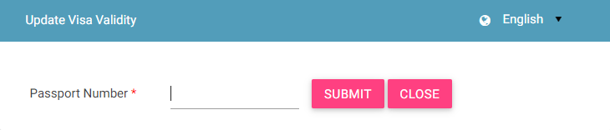
Update Visa (step by step)

Slide 13
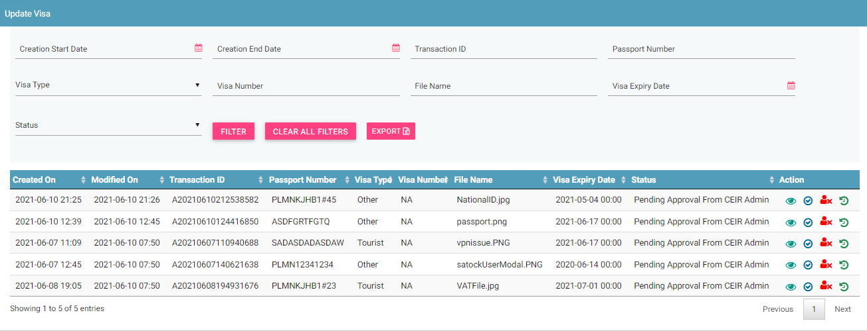
View All Visa Request (CEIR Admin portal)
Filters
Action like View, Approve, Reject, History
Export
View All Request

Slide 14
Action List
Action are enabled / disabled based on the state of the request.

Slide 15
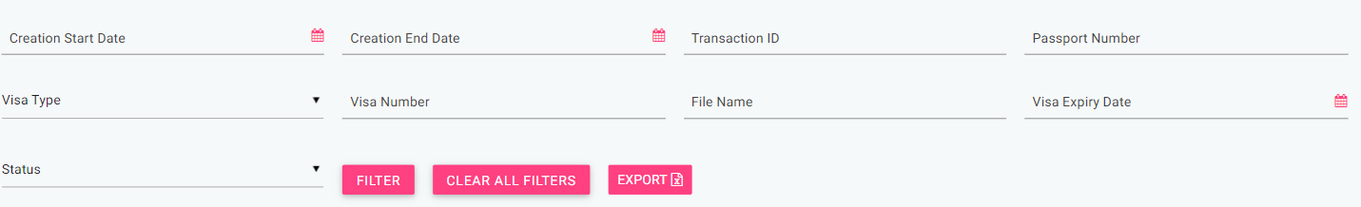
CEIR Admin Portal
By default, request with status “Pending approval from CEIR Admin” will be displayed in the CEIR Admin queue.
In case CEIR Admin wishes to view request in any other state, they can use the filter options to display the same.
For request status as PENDING APPROVAL FROM CEIR AUTHORITY, actions like View, Approve, Reject and Withdraw all will be enabled for CEIR Admin.
For request status as REJECTED BY CEIR AUTHORITY , actions like View, Approve and Withdraw will be enabled for CEIR Admin.
For request status as WITHDRAWN BY CEIR, only View option will be enabled for CEIR Admin.
All other states will have only View option enabled for CEIR Admin

Slide 16
Visa Update - User Flow
End User want to update visa.
In order to update visa details , a End User needs to furnish the following details:
Passport number to identity
Visa Details
If user is not already registered, user will be asked to registered first.
A unique Transaction ID is generated for each new request which is registered. This transaction id can be used in future for raising grievance (if any) regarding the request. The transaction ID will be used for tracking the reqeust at any state.
System processing is being done at the backend. Status = PROCESSING
In case the request is rejected by system. Status = REJECTED BY SYSTEM
System rejects the request in case there is some issue with the format of the request.

Slide 17
Visa Update Flow ( contd..)
After successful internal processing, the request is sent to the CEIR Admin queue for Approval/ Rejection. Status = PENDING APPROVAL FROM CEIR ADMIN.
CEIR Admin rejects the request. Status = REJECTED BY CEIR. Email is sent to End user if Email ID is registered..
CEIR Admin can also withdraw request. Status = WITHDRAWN BY CEIR.
CEIR Authority approves the request. Status = APPROVED. Email is sent to End user if email id is registered.

Slide 18
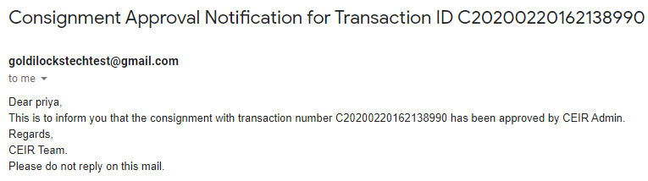
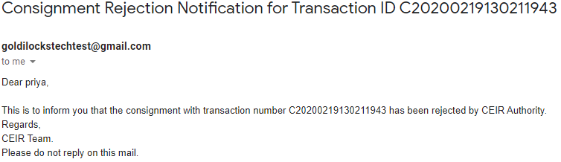
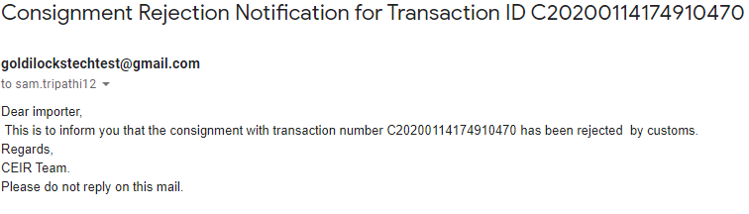
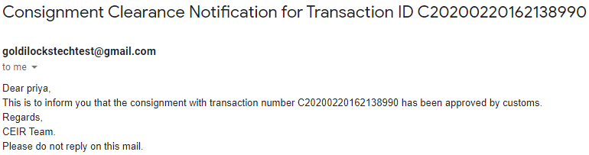
Email samples
Approved by CEIR
Rejected by CEIR
Pending Approval from CEIR Authority
Rejected by System
Email contents can be configured from the System Admin portal. This will be explained in detail in the system configuration training.

Slide 19
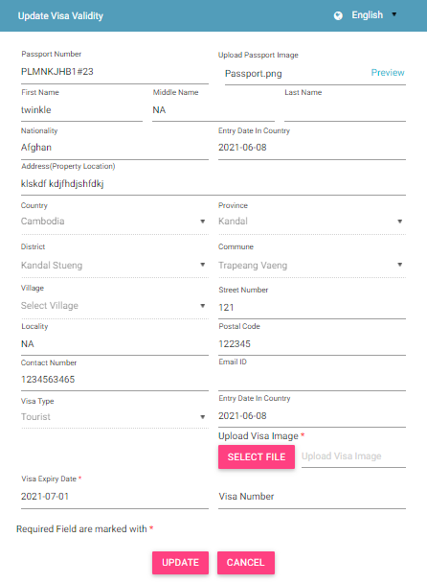
Visa Update – Registered User

Slide 20
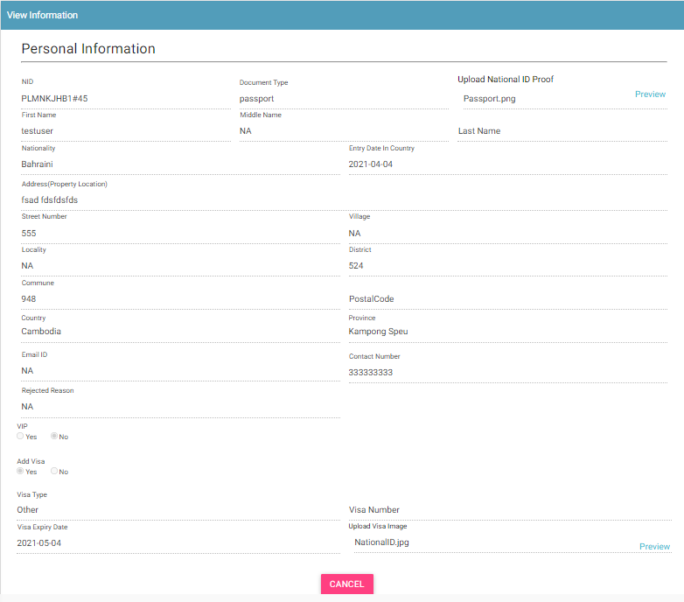
View Visa Update Request
Who all can view the request?
CEIR Admin

Slide 21
System Processing
All NEW request will be processed in FIFO order by the system
Once the processing starts, the status is changed to PROCESSING to indicate that Work is in progress
Once the processing is complete, the status is changed to either REJECTED_BY_SYSTEM or SUCCESS (PENDING_APPROVAL_FROM_CEIR_AUTHORITY)
Post processing an e-mail notification is sent to End User in case of REJECTED_BY_SYSTEM and in case of SUCCESS email is sent to both Mobile Operator and CEIR Admin.

Slide 22
System Processing – Visa Update Case
If all the visa update request is processing successfully, then IMEI expiry date in whitelist is extended

Slide 23
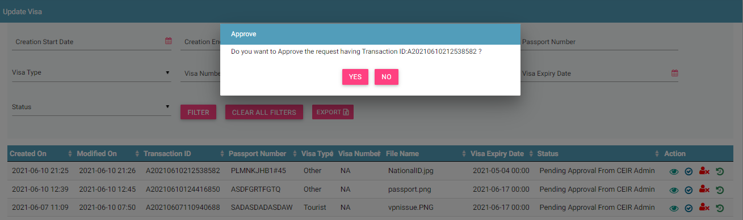
Request Approved by CEIR Admin
Request after successful processing are sent to the CEIR Admin queue for Approval / Rejection.
On Rejection, email is send to end user

Slide 24
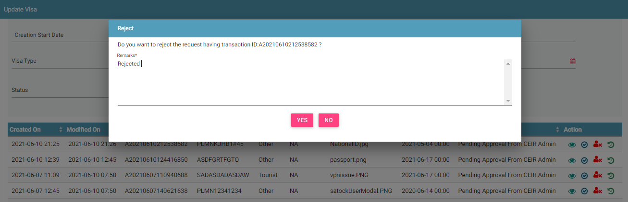
Request Rejected by CEIR Admin
CEIR Admin has the authority to reject any request. Remarks have to be updated for the same.

Slide 25
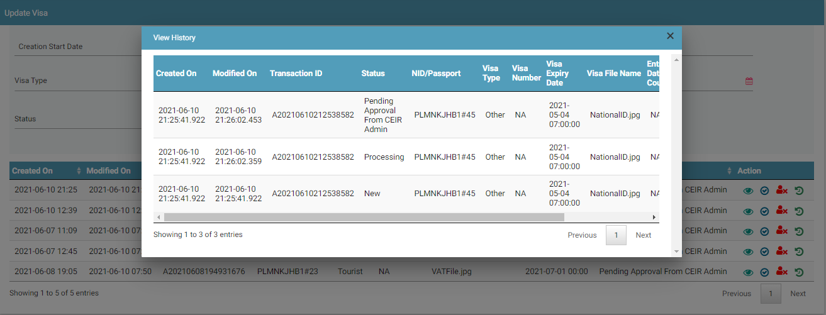
View History
CEIR Admin has the authority to withdraw any request. Remarks have to be updated for the same.

Slide 26
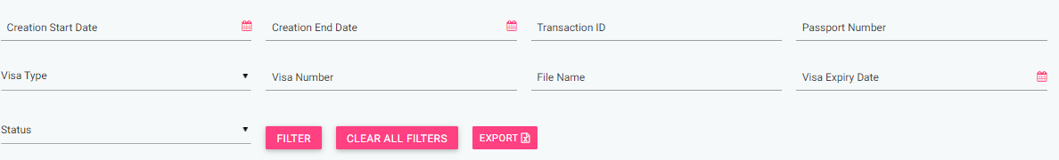
Filter Visa Update Request
Request can be filtered on the basis of
Date filters
Transaction ID
Passport Number
VISA Type
Visa Number
File Number Visa Expiry Date
Status
Users can view old request using the date filter.
User (CEIR Admin) can also use a combination of more than one filters to filter the consignments.

Slide 27
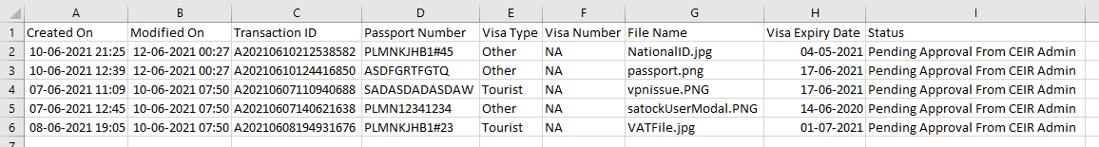
Export Visa Update Request
Requests can be exported in a .csv file using the export button.
User can export all request assigned to the respective user.
User can export filtered requesst.

Slide 28
Policy
Policy for grace and post grace period will be same for updating visa devices
There is no such policy for this feature

Slide 29
Queries

Slide 30
Thank You

